Slide 1

Week #5
AI Academy®
1
Day 1:
What is Jquery?
Why we use?
Linking Jquery
Jquery Selectors
Reviews & Feedbacks

Slide 2
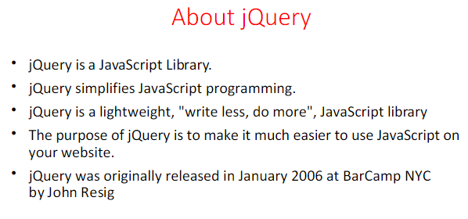
Week #5
AI Academy®
2

Slide 3
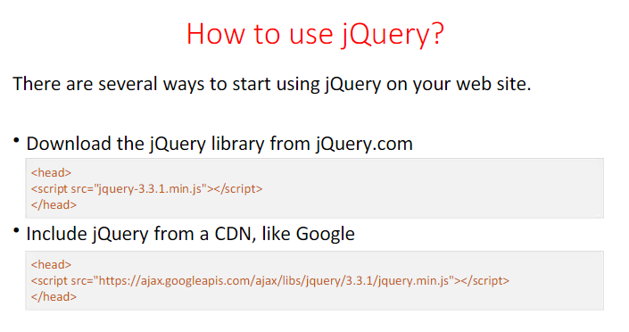
Week #5
AI Academy®
3

Slide 4
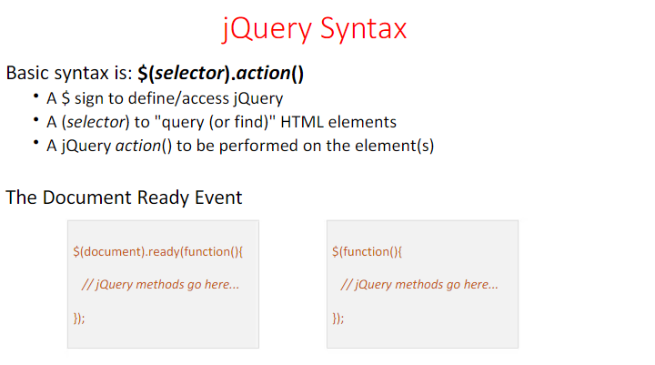
Week #5
AI Academy®
4

Slide 5
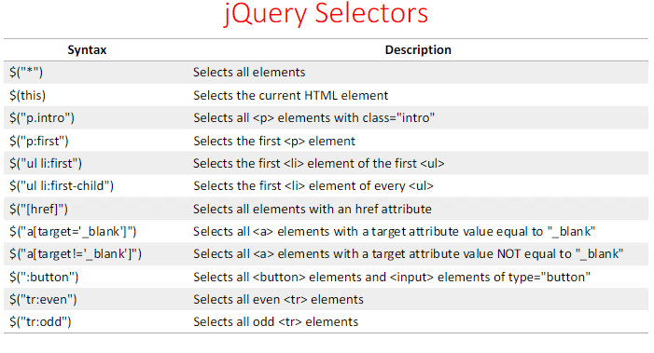
Week #5
AI Academy®
5

Slide 6
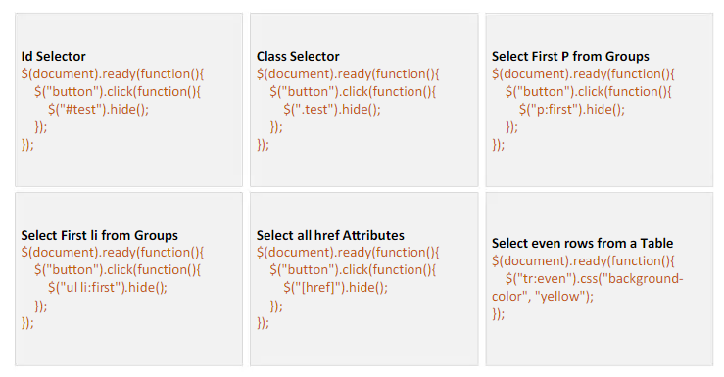
Week #5
AI Academy®
6

Slide 7
Week #5
AI Academy®
7
Day 2:
Jquery Events
Jquery Effects
Why use Events
Reviews & Feedbacks

Slide 8
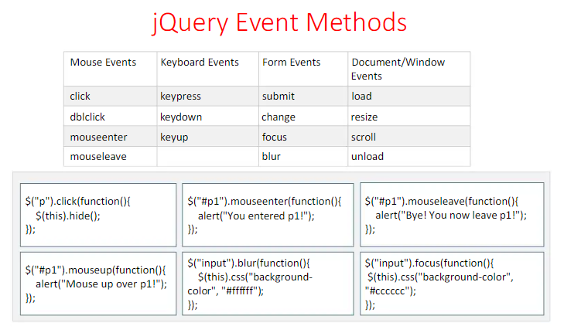
Week #5
AI Academy®
8

Slide 9
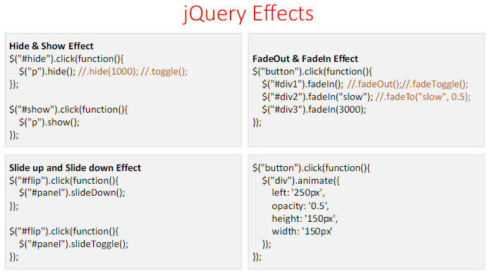
Week #5
AI Academy®
9

Slide 10
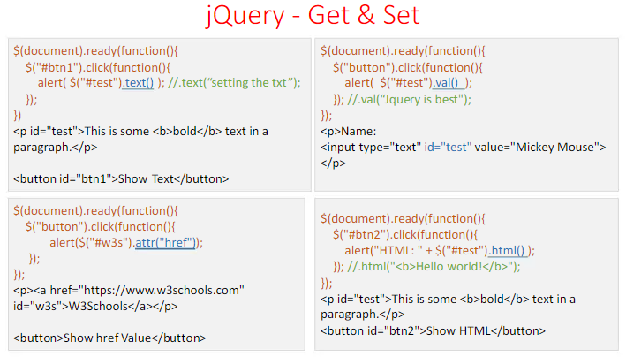
Week #5
AI Academy®
10

Slide 11
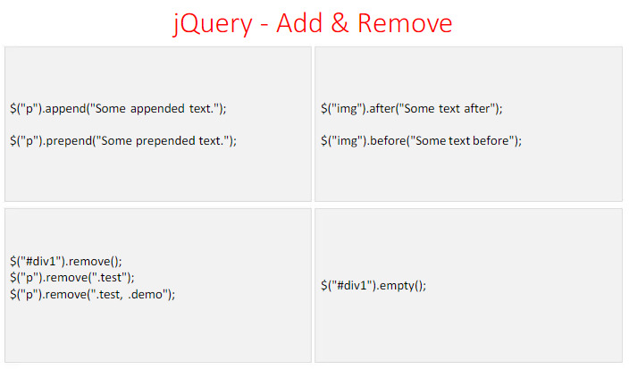
Week #5
AI Academy®
11

Slide 12
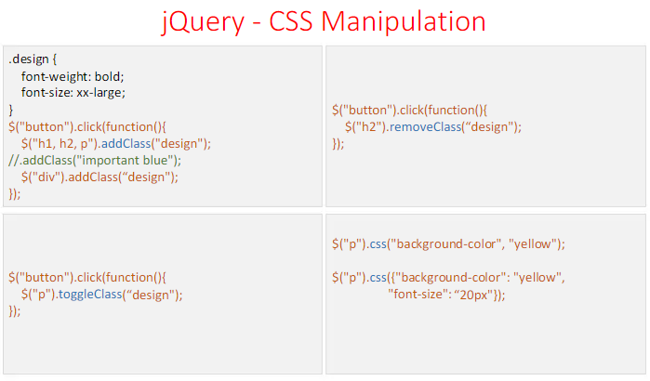
Week #5
AI Academy®
12

Slide 13
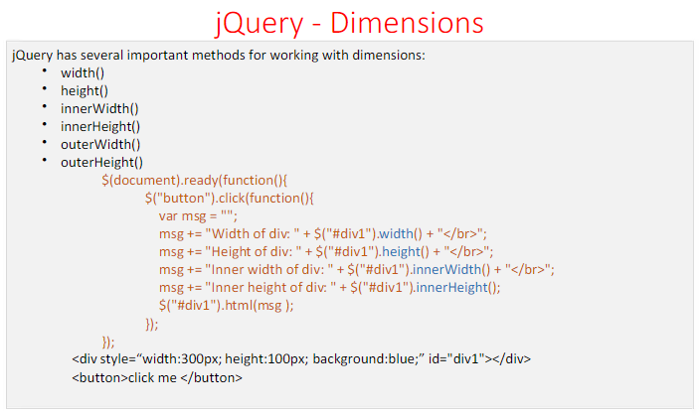
Week #5
AI Academy®
13

Slide 14
Week #5
AI Academy®
14
Day 3:
Overview of PHP
Variables
Constants
Output Statements
Reviews & Feedbacks

Slide 15
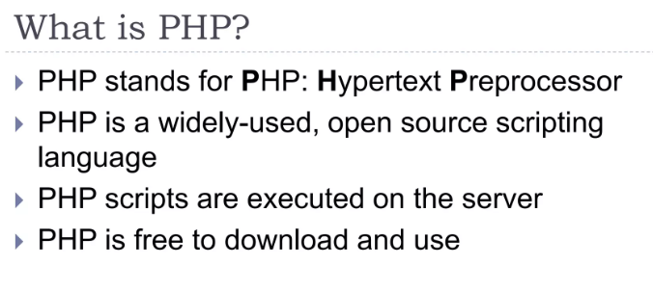
Week #5
AI Academy®
15

Slide 16
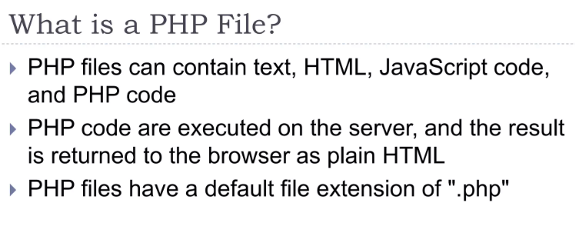
Week #5
AI Academy®
16

Slide 17
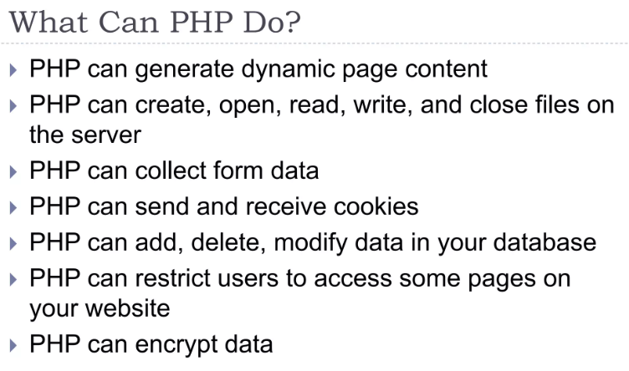
Week #5
AI Academy®
17

Slide 18
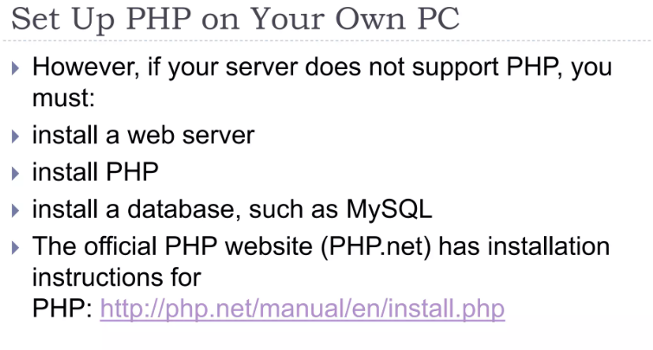
Week #5
AI Academy®
18

Slide 19
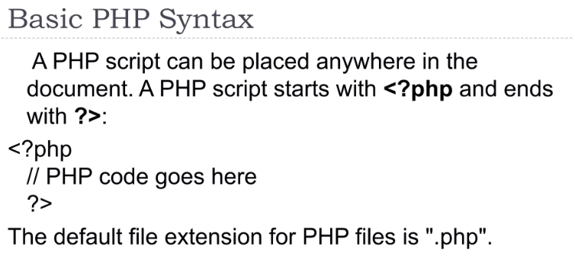
Week #5
AI Academy®
19

Slide 20
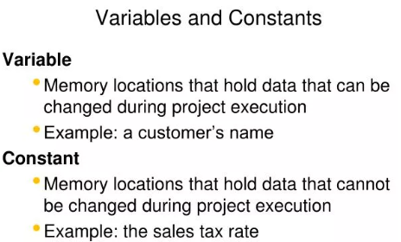
Week #5
AI Academy®
20

Slide 21
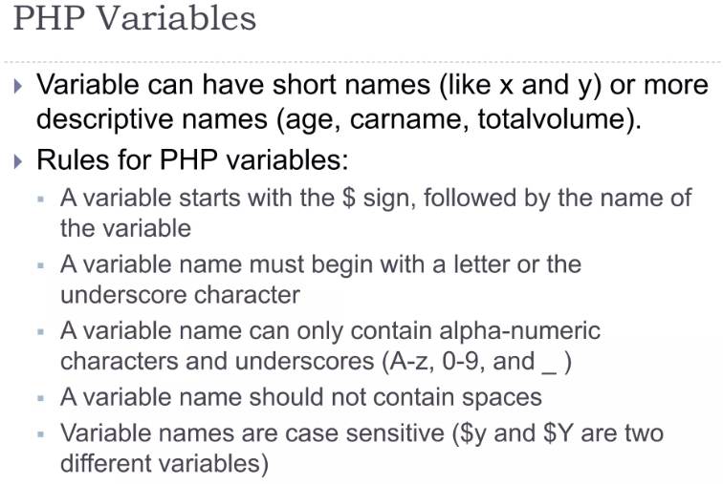
Week #5
AI Academy®
21

Slide 22
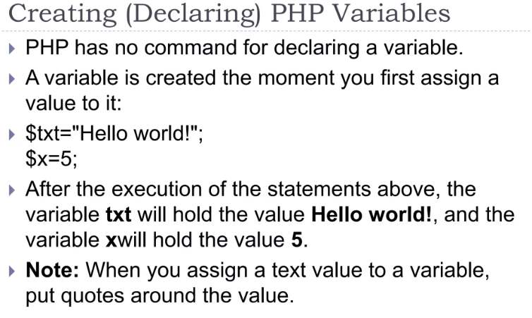
Week #5
AI Academy®
22

Slide 23
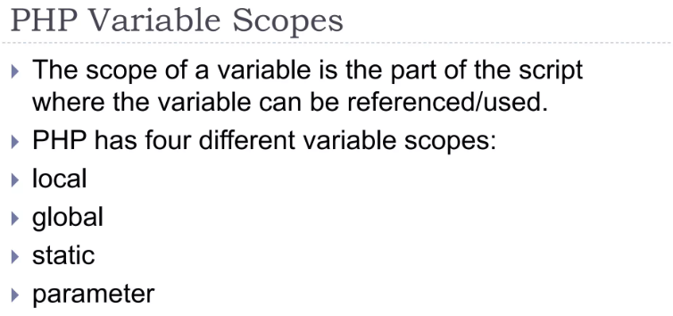
Week #5
AI Academy®
23

Slide 24
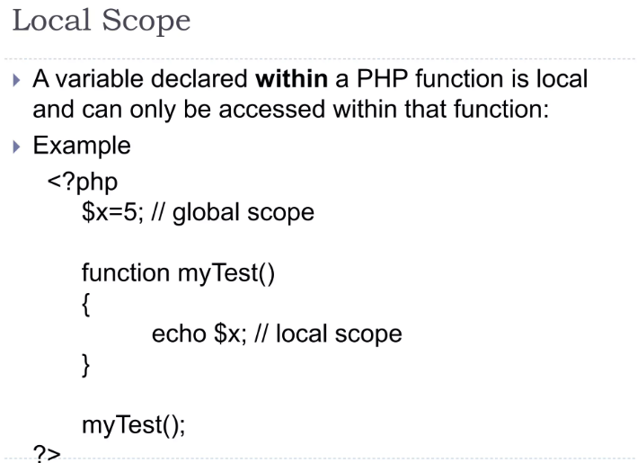
Week #5
AI Academy®
24

Slide 25
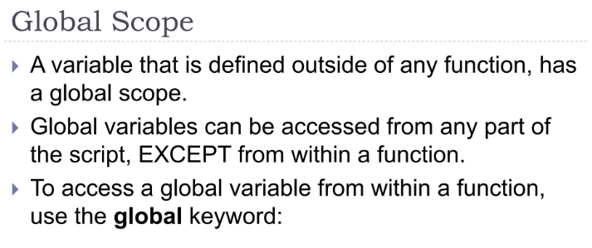
Week #5
AI Academy®
25

Slide 26
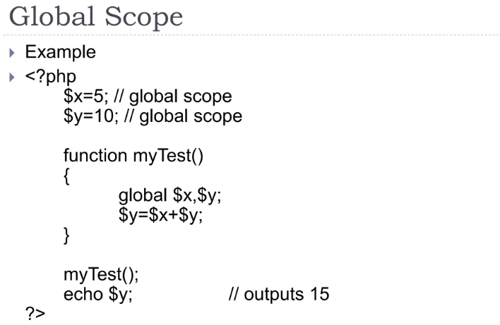
Week #5
AI Academy®
26

Slide 27
Week #5
AI Academy®
27
Day 4:
Operators
Why use Operators?
Decision Making
Reviews & Feedbacks

Slide 28

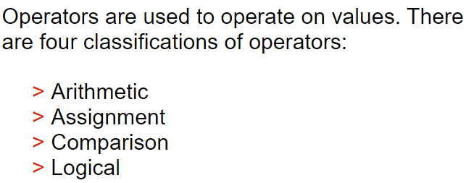
Week #5
AI Academy®
28

Slide 29
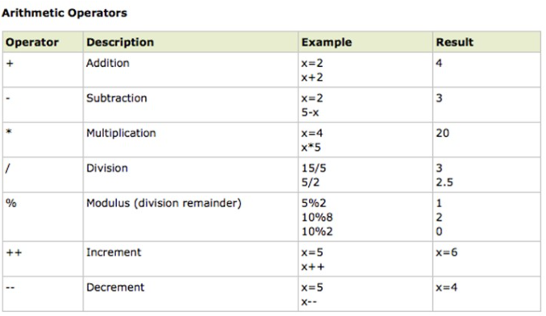
Week #5
AI Academy®
29

Slide 30
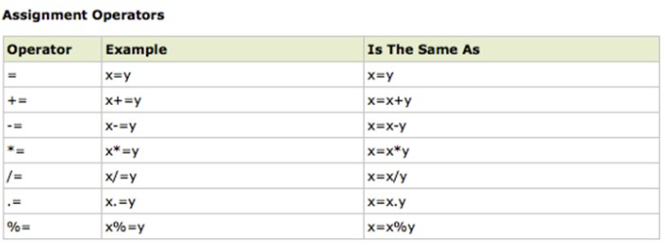
Week #5
AI Academy®
30

Slide 31
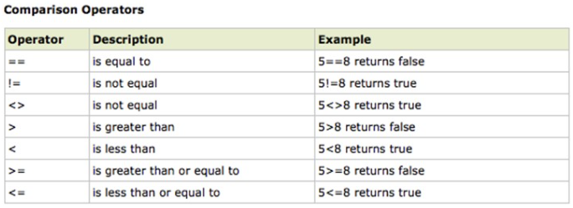
Week #5
AI Academy®
31

Slide 32
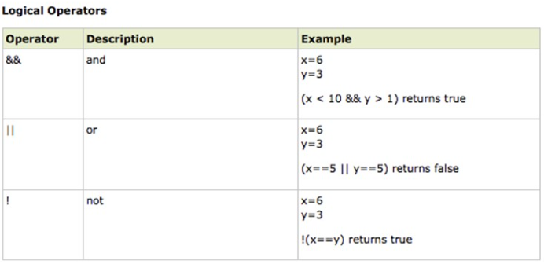
Week #5
AI Academy®
32

Slide 33
Week #5
AI Academy®
33
Day 5:
Loop Types
Why use Loops?
Reviews & Feedbacks

Slide 34

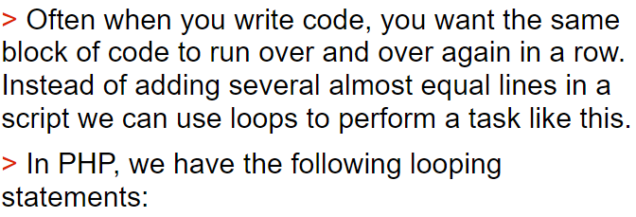
Week #5
AI Academy®
34

Slide 35
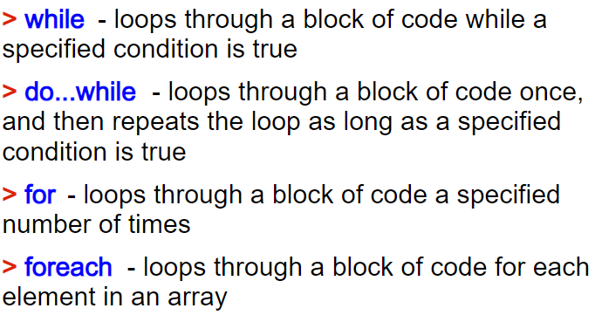
Week #5
AI Academy®
35

Slide 36

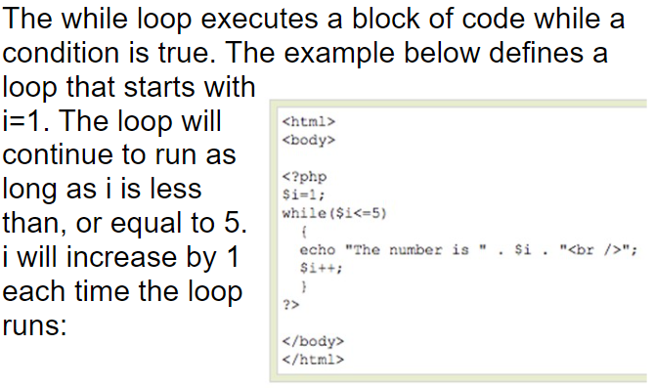
Week #5
AI Academy®
36

Slide 37

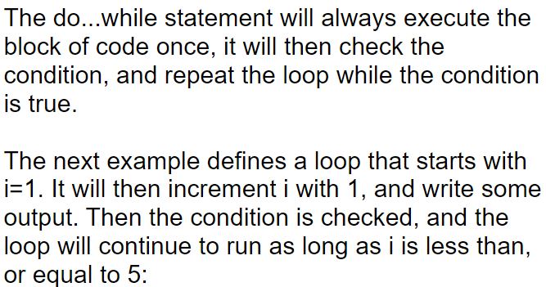
Week #5
AI Academy®
37

Slide 38
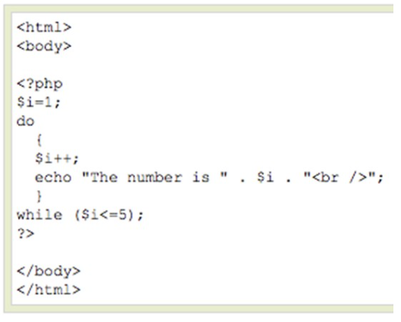
Week #5
AI Academy®
38

Slide 39

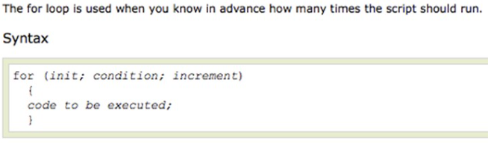
Week #5
AI Academy®
39

Slide 40
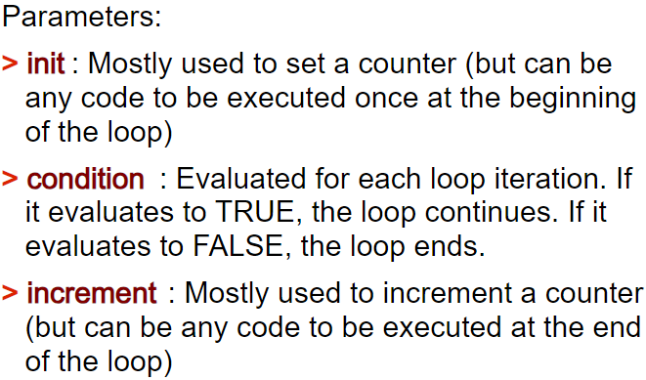
Week #5
AI Academy®
40

Slide 41
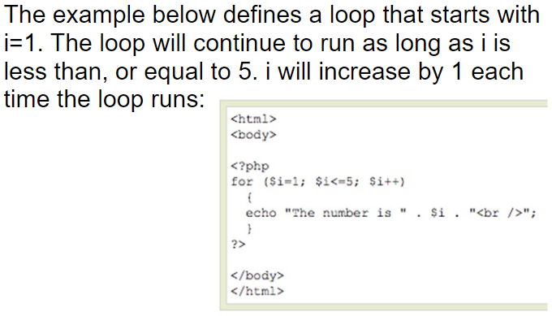
Week #5
AI Academy®
41

